Slide 1
Authorization and Authentication for OAD Programming
in BLE Devices
EE 5392 Project in Electrical Engineering
by
Shreyas Gune
shreyas.enug@gmail.com

Slide 2

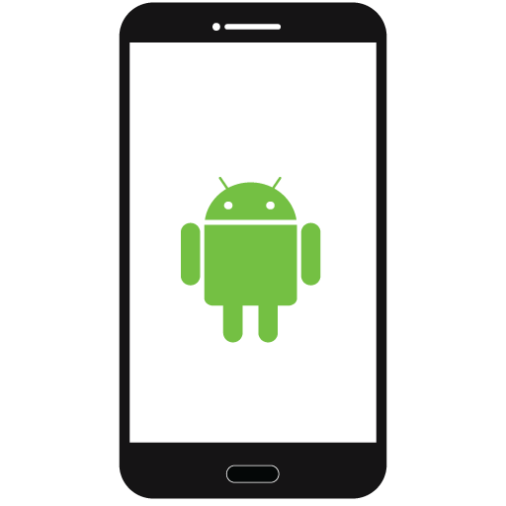
General Idea
SERVER (SLAVE) Firmware BLE Device
CLIENT (MASTER) Android App (v 4.4)
READ/WRITE
SECURITY Key Randomizer RSA Encrypted Authentication
Authorization
OAD Activity Firmware Update
Server Access Database Access Any other Application

Slide 3
What is Bluetooth Smart (Bluetooth LE) ?
Low Energy Solution Technology to implement IoT.
Small, infrequent data.
No concept of data throughput.
Energy consumption : 45 Micro Joules/transaction.
Technical Specs :
Current Consumption : <15mA
Security: 128bit AES OTA
Advertising Channels : 2402, 2426, 2480 MHz, Data Channels : 37
Adaptive Frequency Hopping, Modulation : GFSK (0.45 ~ 0.55 MI)
Latency: 6ms
TTL : 3ms
Notes:
if we have a radio technology that have packets that are longer than 3 ms ,
it takes considerable amount of energy to keep sending those packets at same frequency.
As the transmission occurs, the actual silicon in the chip is heating up, that changes the characteristics of the silicon,
which changes the frequency.
While transmission, the radio needs to be recalibrated on multiple occasions
and to avoid this, we have the coin-cell operation.

Slide 4
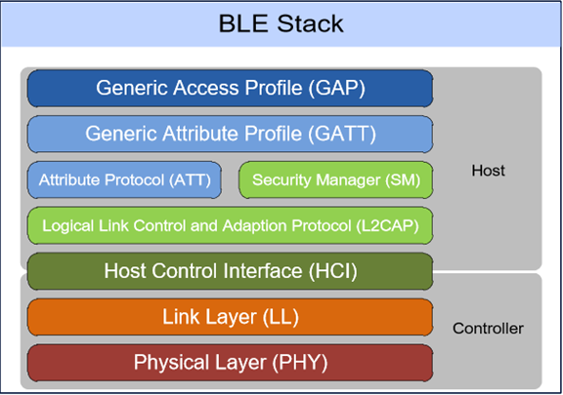
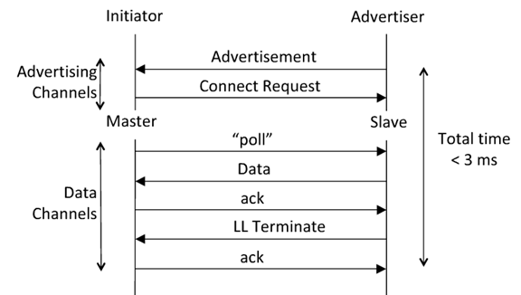
Bluetooth Smart (Bluetooth LE)
Master - Slave Architecture
Notes:
Physical Layer – transmits and receives bits of information over a wireless medium.
Link Layer – receives this bits and sees them as packets and offers protocols to control these packets sending.
HCI – it’s an Host/Controller interface allowing one to have ‘swappable parts’ , which means you can swap out the chips based on your whims and fancy without much hassle.
L2CAP – Above the controller, there are different channels and each of them performs a different purpose. L2CAP is a multiplexing layer between those channels. It manages 3 fixed channels. Two of them are dedicated for higher protocol layers like ATT, SMP. One is used for LE-L2CAP protocol signaling channel for custom use.
Attribute Protocol – Reading and Writing data on the device. Defines a client/server architecture above BLE logical transport channel. It allows a device to expose a set of attributes and associated values to peer devices. These can be discovered, read and written by a client.
Attribute Profile – Defines the services and meta-attributes on the device.
Security Manager – Defines the procedures and behavior to manage pairing and encryption between devices.
Device Profiles – What we could actually do on these devices (leveraging data registers, sensors etc)

Slide 5
Internet of Things
The inter-network of small scale physical objects
Capable of dynamic data collection &
Data exchange is known as Internet of Things (IoT).
Developers resources.
Current devices NOT internet ready.
Applications
Traffic signals, airports, smart hospitals.
Industrial and automation circles, households and events, among countless others.
Industries are rolling out a number of devices.
Use of RFID, QR Tags, Zigbee, Bluetooth Low Energy.
Low power sources for longer device battery life. (eg.coin cell)
Rich platform for developers.

Slide 6
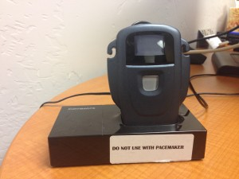
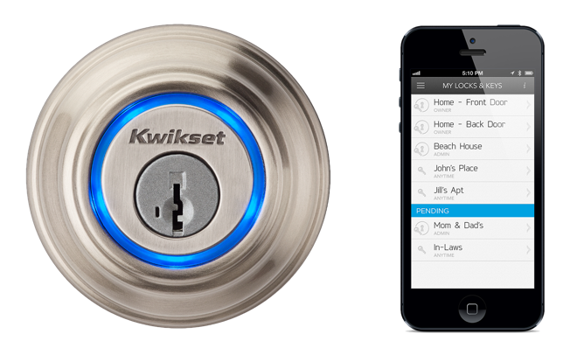
Motivation
OAD is the only way to perform remote update.
Does not have authentication or authorization mechanism.
Anyone with stock client app can update custom firmware.
Applications include: home security, kitchens, automation, controls and medical applications.
Malicious firmware to these can cause havoc.
No Authentication on Android. Some GATT security exists on custom serial interface projects.

Slide 7
Proposed Solution
Custom Server service
Deployed on the Bluetooth Low Energy Device
Implements a security algorithm
The algorithm authorizes and authenticates a specific client.
Enables ability to OAD Firmware Update.
Performs verification of the received information
Grants a seed value that is pre-decided on both client and server.
Custom Client Application
Communicates with Bluetooth LE device
Reads data attributes from the device
Writes back a response to the device.
Decrypts the seed value and enables OAD functionality only if the seed matches.

Slide 8
Security on Bluetooth LE
JustWorks which uses a temporary of ‘0’ as a constant value.
PIN Exchange routing: Max LEN 6 digits ; not that hard to brute-force.
OOB (Out of Band) : needs computers, display units and other IO peripherals.
PDU Encryption is AES-CCM (WPA-AES). Usual sniffing involves sniffing of initial pairing key exchange.

Slide 9
Getting around Bluetooth Security
Intruder observes pairing/key exchange using Ubertooth.
If JustWorks or 6 digit PIN, with good computational resources, Intruder obtains the Temporary Key (TK).
With TK and pairing data, intruder recovers the Short Term Key(STK).
With the STK and key exchange data that is being observed, intruder recovers the Long Term Key (LTK or session key).
*“Vol. 3, Part H, Section 2.3.1 Bluetooth Core spec: "For LE Legacy Pairing, none of the pairing methods provide protection against a passive eavesdropper during the pairing process as predictable or easily established values for TK are used.“

Slide 10
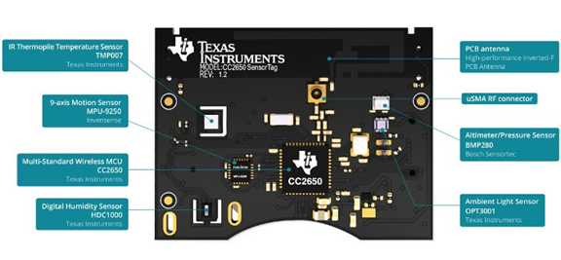
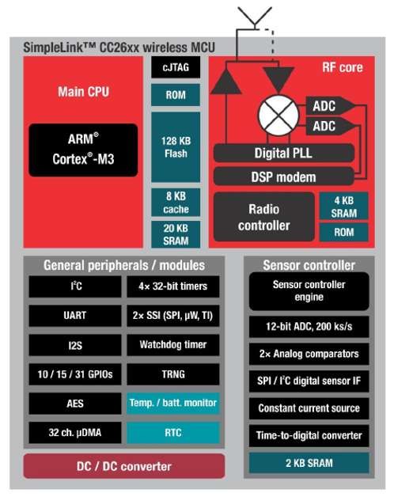
TI’s SensorTag - I : Overview
Texas Instruments CC2640 :
low power consuming,
coin cell battery operated sensor-development platform
for developing single mode BLE Applications.
2.4GHz RF Tx/Rx,
128kB memory,
20kB of SRAM with sensor peripherals.
ARM Cortex-M3 processor
ARM Cortex-Mo radio control processor.

Slide 11
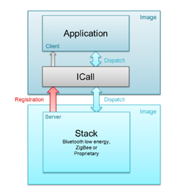
SensorTag : Software Architecture
The BLE stack and Application exist as separate entities on the RTOS.
ICall- Indirect Call Framework, helps interact with BLE protocol stack services and thread synchronization.

Slide 12
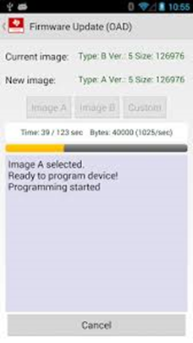
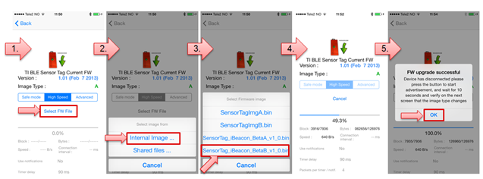
OAD for SensorTag : With Live Demo

Slide 13
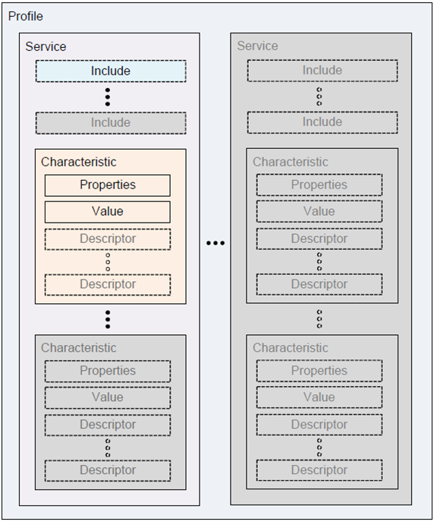
Custom Service Deployment : SensorTag
MVC paradigm :
Model = Server,
View = Characteristic,
Controller = Writable Characteristics.
The custom service I have defined is..
Modeled in the GATT (Generic Attribute Profile) paradigm
Sits on top of the ATT (Attribute Protocol)
Functions in the SERVER role as a SLAVE.
Notes:
The GATT server stores the data transported over the Attribute Protocol and accepts Attribute Protocol requests, commands and confirmations from the GATT client. The GATT server sends responses to requests and when configured, sends indication and notifications asynchronously to the GATT client when specified events occur on the GATT server. GATT also specifies the format of data contained on the GATT server.

Slide 14
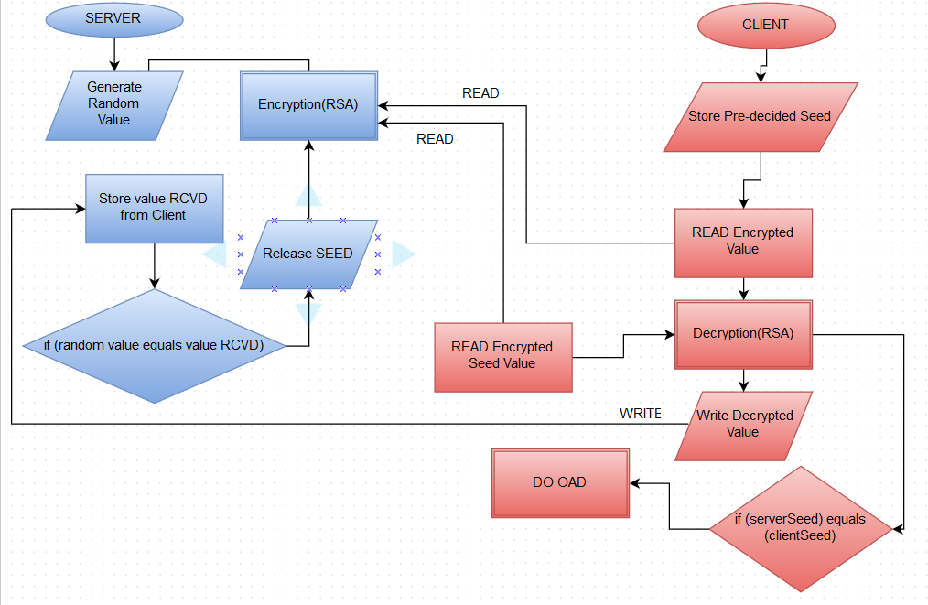
GuneSec Algorithm

Slide 15
Firmware Activity
Has security service configured and invoked.
Custom UUID’s help define and recognize service elements.
Defines Characteristics and provides properties.
Provides data attributes to READ from.
Provides data attributes to WRITE to.
Performs Encryption (RSA).
Stock Image has OAD bits enabled.

Slide 16
Firmware Code Snippet for GuneSec - I
Services in SensorTag (BTLE) : C array containing pre-defined constants
Contain Characteristics linked to UUIDs , Size and Type and Permissions.
Function calls to register them.
This is called creating an Attribute Table.
These services are registered in master <SensorTag.c>
static gattAttribute_t securityAttrTable[] = { { // Service declaration {
ATT_BT_UUID_SIZE, SecurityServiceUUID }, /* type */ GATT_PERMIT_READ, /* permissions */ 0, /* handle */ (uint8 *)&ServiceValue /* pValue */
},
// Characteristic Declaration { { ATT_BT_UUID_SIZE, characterUUID
}, GATT_PERMIT_READ, 0, &SecurityDataProps },
// Characteristic Value "Data" { { MW_UUID_SIZE, //UUID SecurityDataUUID
}, GATT_PERMIT_READ | GATT_PERMIT_WRITE, 0, SecurityData }

Slide 17
Firmware Code Snippet for GuneSec - II
3 Permitted Callbacks : READ , WRITE and NOTIFY.
I have implemented them for R/W modes.
The READ/WRITE callback executes the UUID switch case
Which parses the data object into memory (memcpy).
static uint8 SecurityReadAttrCB (args)
{
uint8 uuid; bStatus_t status = Success; switch(uuid) {
case UUID: memcpy(pValue,data[0],LEN); { do what you want with data[0]
} break; return(status); }
CONST gattServiceCBs_t SeurityCBs = { Security_ReadAttrCB,
// Read callback function pointer counter_WriteAttrCB,
// Write callback function pointer NULL // Authorization callback function pointer };
// Register GATT attribute list and CBs with GATT Server App
status = GATTServApp_RegisterService
(
SecurityAttrTable, GATT_NUM_ATTRS( SecurityAttrTable), &SecurityCBs );

Slide 18
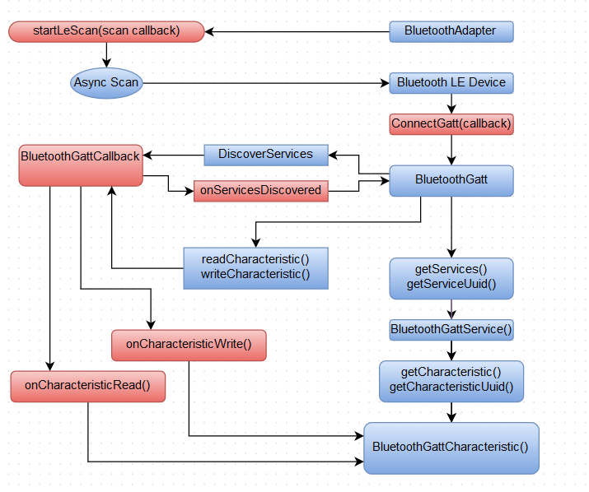
Android Flow

Slide 19
Demo : GuneSec
Challenges Encountered :
Testing was hard : Unstable behavior of stack.
Using higher key-values for RSA breaks thread behavior : FW and Android
Setting constants for characteristic data causes compile errors.
Invoking API calls that trigger callbacks was tricky/complicated.
Android OS behavior needs context and view declarations.
Threading issues for different views.
Calling data-variables within scope of FW, causes undesired callbacks.
Loops do not work for READ/WRITE Callbacks.

Slide 20
Power Consideration for SensorTag
Stock firmware (LED Blinking) : 0.35 ~ 1.24 → 2mA(max)
Connecting to SensorTag App : 4.7mA(max)
All Sensors OFF : 0.50 mA
Only Motion Sensor (Accelo,Gyro,Magneto) : 4.20mA
Humidity+Temp Only : 0.76mA
Fast Data Rate : 1mA
All sensors ON, max refresh rate : 5.28mA
Tests done with 3 batteries(2.6V, 3.0V, 3.06V)
ONLY BEACON FW : Does not work for below 3.0V
Stock SensorTag FW : Does not work for below 3.0V
Depreciation for Beacon FW : 3.06V → 2.6V in 2 weeks.
In Modest conditions @ 2.0mA , it will still only last : 120 hrs of runtime.

Slide 21
Future Tests and Extensions
Cloning the same service on iOS and Windows Phone / WindowsRT platform.
Testing the service on other Bluetooth LE Devices
Implementing Diffie-Helmann Algorithm
Testing other security encryption standards.
Conducting Power-Consumption Survey of said tests.
Submitting the algorithm for standardisation

Slide 22
Resources Repositories
Firmware Code Repo : https://github.com/shreyasgune/SensorTagFirmware
Android Client App Repo : https://github.com/shreyasgune/Android-SensorTag-Security
Ubertooth : https://github.com/greatscottgadgets/ubertooth
TI Resources : Softwares and Stacks : http://www.ti.com/tool/sensortag-sw Google : http://developer.android.com/guide/topics/connectivity/bluetooth-le.html https://github.com/googlesamples

Slide 23
Questions and Comments
TI’s Bluetooth Stack is unstable.
Android Bluetooth Stack / API is unstable. App crashes periodically.
The Battery performance for SensorTag is questionable.
Need more Bluetooth LE devices to test the complete robustness of the algorithm.

Slide 24
Thank You.
Dr. Yonghe Liu
Chunhai Feng
Dr. Bredow , Dr. Dillon , Madam Pauline , Madam Ann , Madam Janice.
Martin Wooley (@bluetooth_mdw) , Mike Ryan, Dave Smith.
Bluetooth SIG , Google Team for their API , folks at Texas Instruments.
Krishna Nambiar , Pradeep Mohan, Abhinav Shankar and Joscelyn Sequira for their feedback.

